Slide 1
UNICEF SPONSORED
Charity Organization
Website Project
Project Management Final Document
Website link: https://fruit-drink 09701047.figma.site/
Jana Hassan & Seif Ahmed — 15 March 2026

Slide 2
Project Overview
Business need, objectives & expected impact
BUSINESS NEED
EXPECTED IMPACT
▸ No professional digital presence for the charity
+40%
Donation accessibility
▸ Limited fundraising and community engagement
▸ No mechanism for online donation collection
+50%
Volunteer registration efficiency
▸ No volunteer recruitment channel
7+
Fully functional website pages
▸ No platform to promote events & projects
<3s
Page load time target
Charity Organization Website | Jana Hassan & Seif Ahmed | UNICEF

Slide 3
Project Charter
Objectives, scope boundaries, milestones & authorization
OBJECTIVES
SCOPE BOUNDARIES
✔ IN SCOPE
1. Full frontend + backend website by 21 Jun 2026
• HTML/CSS/JS frontend
2. All 8 pages with error-free navigation by 25 May
• Responsive design
• Basic backend support
• Form validation
3. Page load time < 3 seconds (Chrome & Edge)
✘ OUT OF SCOPE
4. 100% form validation pass rate by 21 Jun 2026
• Native mobile app
• Live hosting
• Real payment gateway
KEY MILESTONES
15 Mar
25 Mar
10 Apr
30 Apr
25 May
15 Jun
21 Jun
Charter
Approval
Req's
Approved
Design
Approved
Dev
Complete
Pages
Done
Testing
Done
Final
Delivery
Charity Organization Website | Jana Hassan & Seif Ahmed | UNICEF

Slide 4
Project Management Plan (PMP)
Seven subsidiary plans + three baselines — the governance backbone of the project
Scope Management Plan
Resource Management Plan
How scope is defined, validated & controlled. Formal CR process enforced.
5-member team. Tuckman model. RAM/RACI defined.
Schedule Management Plan
Risk Management Plan
CPM + PERT. 8 milestones. Weekly SPI tracking. Jira + Gantt.
12 risks identified. P×I matrix. Top-10 tracking weekly.
Cost Management Plan
Communication Management Plan
Bottom-up estimation. EVM weekly. $4,620 total budget.
15 channels. Push/Pull/Interactive. Weekly status reports.
Quality Management Plan
THREE BASELINES
ISO 9000. Control charts, Pareto, defect tracking in Jira.
Scope Baseline | Schedule Baseline | Cost Baseline ($4,400)
Charity Organization Website | Jana Hassan & Seif Ahmed | UNICEF

Slide 5
Scope & Schedule Management Plans
How scope is controlled and schedule is developed
SCOPE MANAGEMENT PLAN
SCHEDULE MANAGEMENT PLAN
Scope Definition
Method: CPM
Scope Statement approved by UNICEF before execution
Critical Path Method + PERT three-point estimates
WBS
Tool: Jira + Gantt
Top-down decomposition into 6 phases, 20 work packages
PDM (Finish-to-Start) network diagram
Scope Validation
Work Calendar
5-step sign-off process with UNICEF at each phase end
Sun–Thu, 8 hrs/day, 70 working days total
Change Control
Performance Metrics
7-step CR process: Submit → Analyze → UNICEF Approve
SV = EV−PV | SPI = EV÷PV (target ≥ 0.90)
Scope Creep Prevention
Control Thresholds
All reqs in Jira. No informal channels. Formal CR required
🟢 ≤2 days | 🟡 3–5 days | 🔴 >5 days → escalate
Charity Organization Website | Jana Hassan & Seif Ahmed | UNICEF

Slide 6
Cost Management Plan & Budget Breakdown
EVM-based cost control with $4,620 total budget
ITEM | AMOUNT
Total Direct Cost (620 hrs × $6.45) | $4,000
Contingency Reserve (10%) | $400
Cost Baseline | $4,400
Management Reserve (5%) | $220
TOTAL PROJECT BUDGET | $4,620
EVM Performance Rules
0/100 rule (≤2 days) • 50/50 rule (3–10 days)
% Complete rule (>10 days) • Review: every Thursday
Charity Organization Website | Jana Hassan & Seif Ahmed | UNICEF

Slide 7
Quality & Resource Management Plans
Quality objectives, team structure and development approach
QUALITY MANAGEMENT PLAN
RESOURCE MANAGEMENT PLAN
Target | Metric | Date
8/8 pages | Error-free navigation | 25 May 2026
< 3 sec | Page load time | 15 Jun 2026
100% | Form validation pass | 21 Jun 2026
0 bugs | Critical defects at delivery | 21 Jun 2026
≥ 95% | UAT test case pass rate | 15 Jun 2026
> 85% | Usability satisfaction score | 10 Apr 2026
UNICEF (Sponsor)
Jana & Seif (PMs)
Lead Dev
Frontend Dev
Tester/QA
Team Development: Tuckman's 5 Stages
Forming
Storming
Norming
Performing
Adjourning
Charity Organization Website | Jana Hassan & Seif Ahmed | UNICEF

Slide 8
Risk Management Plan
Risk register, P×I matrix and top risks
PROBABILITY × IMPACT MATRIX
ID | Risk Name | Score | Strategy
R01 | Scope Creep | 9 | Mitigate
R02 | Key Member Unavailability | 9 | Mitigate
R03 | Schedule Delay – Dev Phase | 6 | Mitigate
R04 | Budget Overrun | 6 | Mitigate
R05 | Poor Quality / High Defects | 6 | Mitigate
R06 | UNICEF Feedback Delays | 6 | Mitigate
R10 | Tool Unavailability | 3 | Accept
HIGH (3)
3 MED
6 HIGH
9 HIGH
↑ Probability
MED (2)
2 LOW
4 MED
6 HIGH
LOW (1)
1 LOW
2 LOW
3 MED
OPPORTUNITIES:
Impact →
O1: Early Development Completion → More testing time | O2: UNICEF Replication Opportunity | O3: Team Skill Development
Charity Organization Website | Jana Hassan & Seif Ahmed | UNICEF

Slide 9
Communication Management Plan
15 channels, 3 communication methods, structured reporting
n(n−1) ÷ 2
↔
Interactive
→
Push
↓
Pull
Weekly meetings, milestone reviews, video calls
Status reports, meeting minutes, risk register
Jira board, document folder, WBS artifacts
6 stakeholders = 15 channels
Communication | Frequency | Audience
Weekly Status Report | Every Thursday | Team + UNICEF
Monthly Sponsor Report | 1st of each month | UNICEF only
EVM Cost Report | Bi-weekly | UNICEF + PMs
Milestone Completion Report | At each milestone | UNICEF + Team
Risk Register Update | Weekly (Thursday) | Team + UNICEF
Change Request Notification | As needed | UNICEF (approval)
Final Project Report | 21 June 2026 | All stakeholders
Charity Organization Website | Jana Hassan & Seif Ahmed | UNICEF

Slide 10
Requirements Traceability Matrix (RTM)
Ensuring all requirements are implemented and tested
# | Requirement Name | Category | Source | Status
R1 | Website Navigation Pages | Functional | Project Charter | ✔ Done
R2 | Online Donation Form | Functional | UNICEF Requirements | ✔ Done
R3 | Volunteer Sign-Up Form | Functional | Stakeholder Interviews | ✔ Done
R4 | Events Calendar | Functional | Stakeholder Interviews | ✔ Done
R7 | Content Management System | Functional | Stakeholder Interviews | ✔ Done
R8 | Simulated Payment Gateway | Functional | Project Charter | ✔ Done
# | Requirement Name | Category | Source | Status
R5 | Responsive UI/UX Design | Design | Project Scope Statement | ✔ Done
R6 | User Authentication & Profile | Security | Security Requirements | ✔ Done
R9 | Page Load Performance | Performance | Scope / Standards | ✔ Done
R10 | Sponsor Acceptance (UNICEF) | Management | Project Charter | ✔ Done
Charity Organization Website | Jana Hassan & Seif Ahmed | UNICEF

Slide 11
Work Breakdown Structure (WBS)
6 phases, 21 work packages — full project decomposition
1.0 Charity Organization Website
1.1
Project
Management
1.2
Requirements
& Design
1.3
Platform
Development
1.4
Feature
Integration
1.5
Testing
& QA
1.6
Deployment
& Launch
Planning & Scoping
Stakeholder Workshops & requirement gathering
Core Infrastructure
CMS
Test Planning
Env. Setup
Resource Management
Architecture & DB
User Auth
Volunteer Module
Unit & Integration
Content population & final review
Tracking & Reporting
UI/UX Prototyping
Dashboards
Donation form
System & UAT
User Training & documentation
Donations Panel
Security & Performance
Final presentation & sponsor sign-off
Charity Organization Website | Jana Hassan & Seif Ahmed | UNICEF

Slide 12
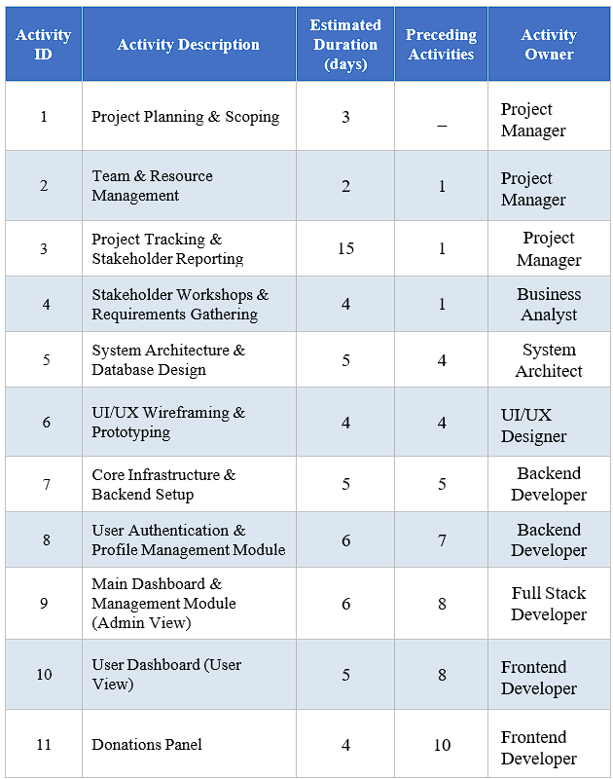
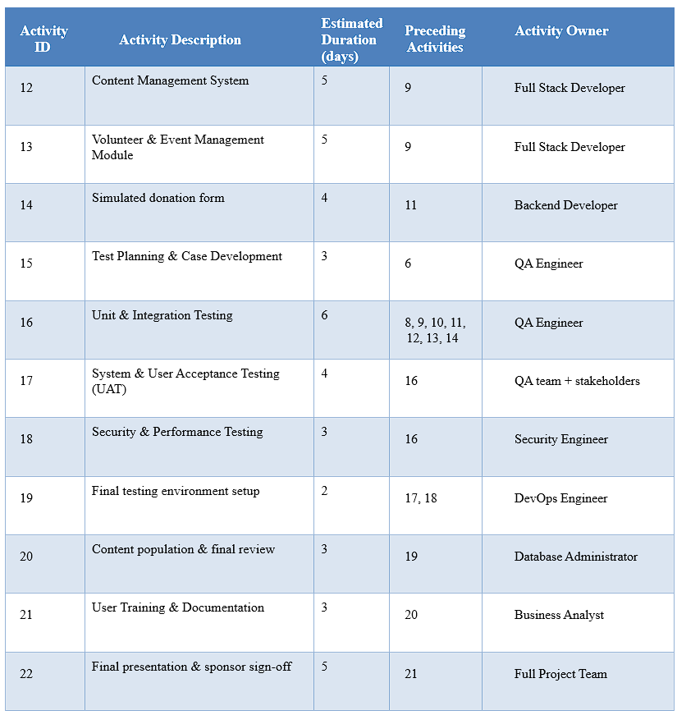
Activity List
22 scheduled activities with durations, predecessors and owners
Charity Organization Website | Jana Hassan & Seif Ahmed | UNICEF

Slide 13
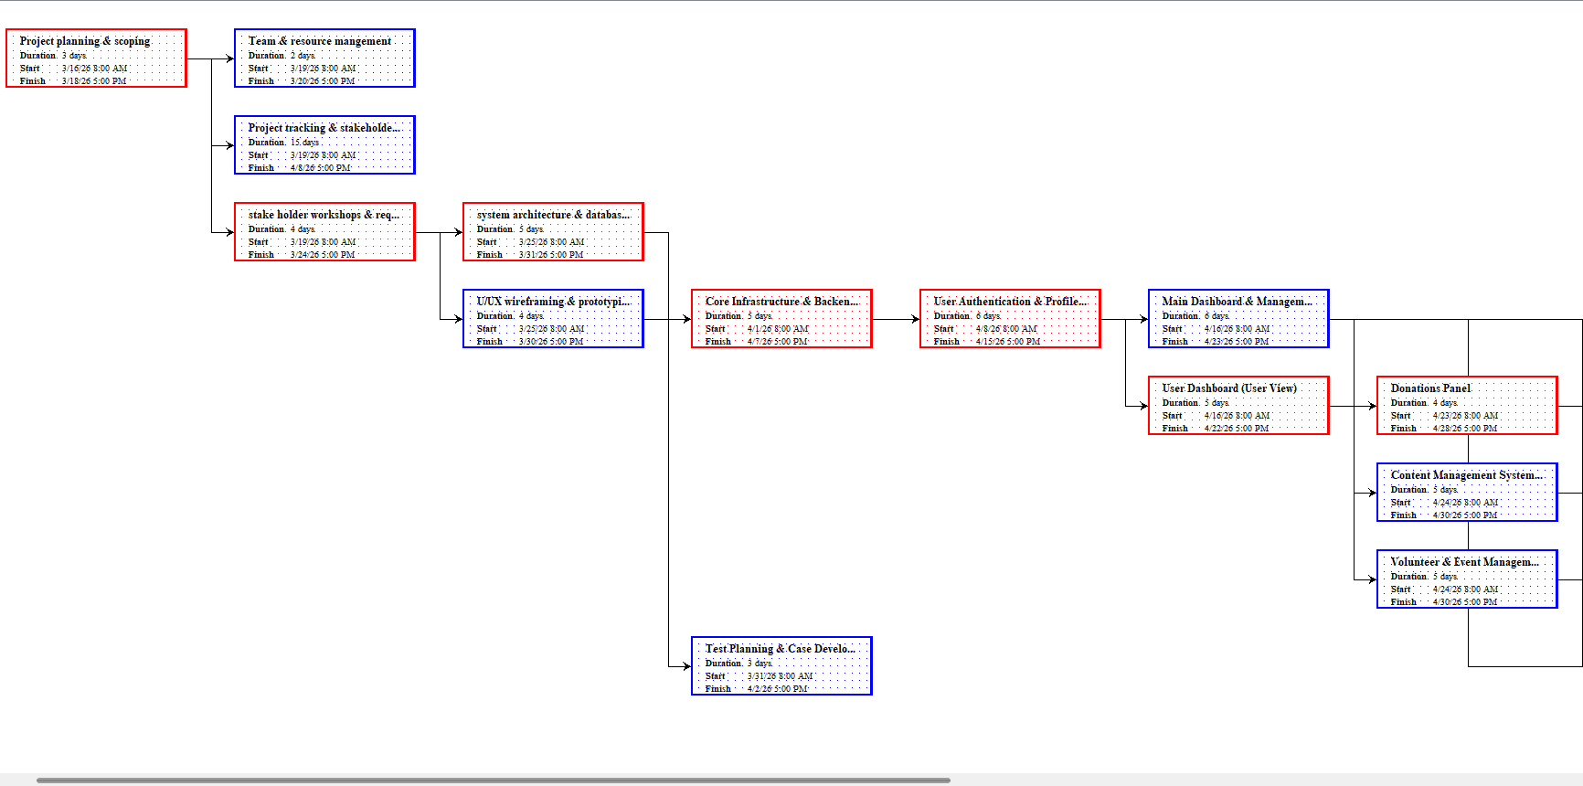
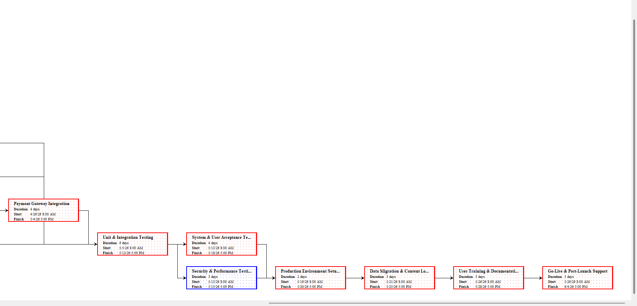
Network Diagram
Precedence Diagramming Method (PDM) — Finish-to-Start dependencies
Charity Organization Website | Jana Hassan & Seif Ahmed | UNICEF

Slide 14
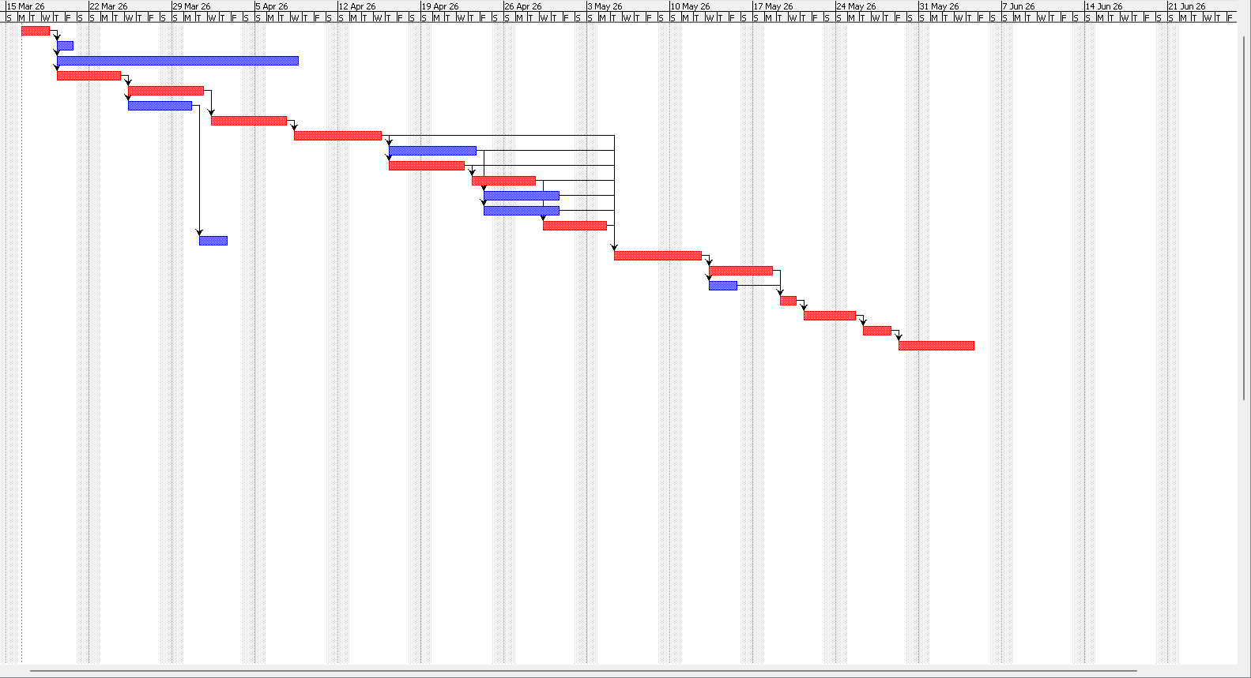
Gantt Chart
Project schedule from 15 March to 21 June 2026 (≈70 working days)
Charity Organization Website | Jana Hassan & Seif Ahmed | UNICEF

Slide 15
Critical Path Analysis
Longest path = 48 days with zero float — determines project end date
Requirements
Gathering (4d)
UI/UX
Design (4d)
Frontend
Dev (5d)
Backend
Dev (6d)
Integration
(5d)
Testing
(6d+4d)
Final
Review (2d)
Delivery
(21 Jun)
Float = 0 days on all critical path activities
~48 working days
70 working days
0 days (zero tolerance)
Daily during execution
Critical Path Duration
Project Duration
Float on Critical Path
Monitoring Frequency
Charity Organization Website | Jana Hassan & Seif Ahmed | UNICEF

Slide 16
Responsibility Assignment Matrix (RAM)
Who has Primary (P) and Responsible (R)
OBS / WBS | 1.1 Project Management | 1.2 Requirement & Design | 1.3 Platform Development | 1.4 Feature Integration | 1.5 Testing & QA | 1.6 Deploy & Launch
Project Management | RP | R | R | R | R | RP
Design & UX | — | RP | P | P | — | —
Front-End Dev | — | P | P | P | P | P
Back-End Dev | — | P | RP | RP | P | P
Quality Assurance | — | — | P | P | RP | P
Sponsor (UNICEF) | R | P | — | — | P | R
R = Responsible of task | P = Perform the task | RP = Responsible + Primary
Charity Organization Website | Jana Hassan & Seif Ahmed | UNICEF

Slide 17
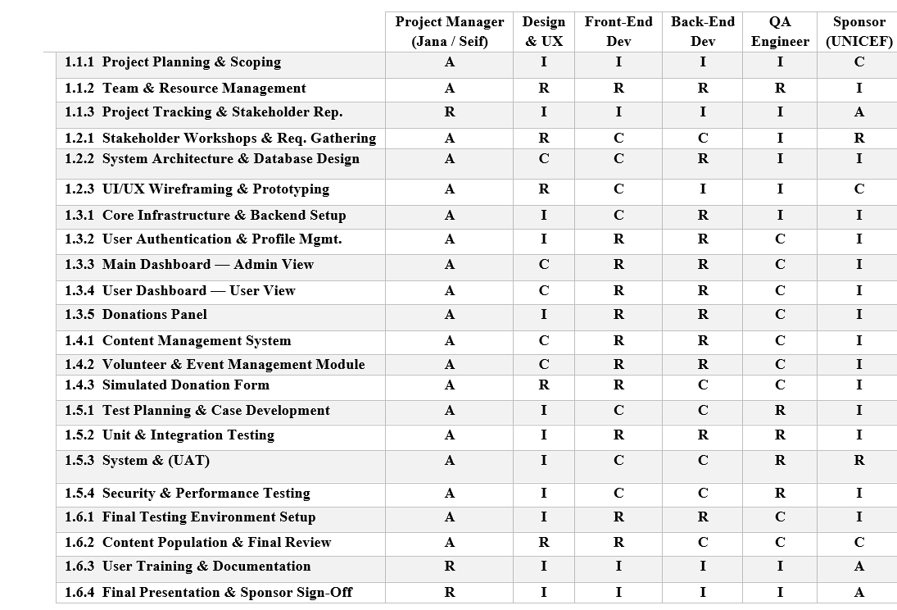
RACI Chart
Responsible = do the task · Accountable · Consulted · Informed
I = Informed
Charity Organization Website | Jana Hassan & Seif Ahmed | UNICEF

Slide 18
Project Summary
Key metrics, status and deliverables briefly
Project Charter
Scope Baseline
Schedule Baseline
Approved 17 Mar 2026
6 phases · 20 WPs · UNICEF Signed
70 working days · 8 milestones
Cost Baseline
Requirements
WBS
$4,400 · Total Budget $4,620
10 requirements · All Done
6 phases · 20 work packages
Activity List
Critical Path
RAM / RACI
22 activities · CPM scheduled
~48 days · Zero float
5-member team · Roles defined
Risks Identified
Comm. Channels
12 threats · 3 opportunities
15 channels · Weekly reporting
Charity Organization Website | Jana Hassan & Seif Ahmed | UNICEF

Slide 19
Thank You
Charity Organization Website Project
Prepared by
Sponsor
Deadline
Jana Hassan & Seif Ahmed
UNICEF
21 June 2026
Questions?
Charity Organization Website | Jana Hassan & Seif Ahmed | UNICEF

